Slide 1





Smart City Knowledge Base (SmartCity-KB)
A Unified Platform for Urban Data
This presentation explores the Smart City Knowledge Base (SmartCity-KB) project, a unified platform for integrating heterogeneous data sources to enhance urban efficiency and livability.
Group A
André Costa
André Lima
Inês Gaspar
up201905916
up202008169
up202007210

Slide 2

Context and Motivation
Smart City Challenges
SmartCity-KB Solution
Smart cities face the challenge of integrating diverse data sources for effective city management, decision-making, and overall enhancing sustainability and livability of urban areas.
SmartCity-KB offers a solution by aggregating city-related information from multiple sources, including static city data, weather info, and real-time bus transportation schedules. This solution incorporates a Web Interface to provide key access points for both machines and people to interact.

Slide 3

Implementation Phases
Scheduled Updates
Data Sources
Data Collection and Conversion
Scripts were optimized to fetch data periodically, ensuring the knowledge base remains current.
Selection of data sources and APIs for data retrieving.
Data was fetched from APIs and converted into RDF using Python scripts.
1
2
3
4
5
Architecture Design
Web App & UI Development
Defining the Entities and connections based on the previous selection.
Developed a Flask & React based web interface to showcase the data in human-readable format.

Slide 4
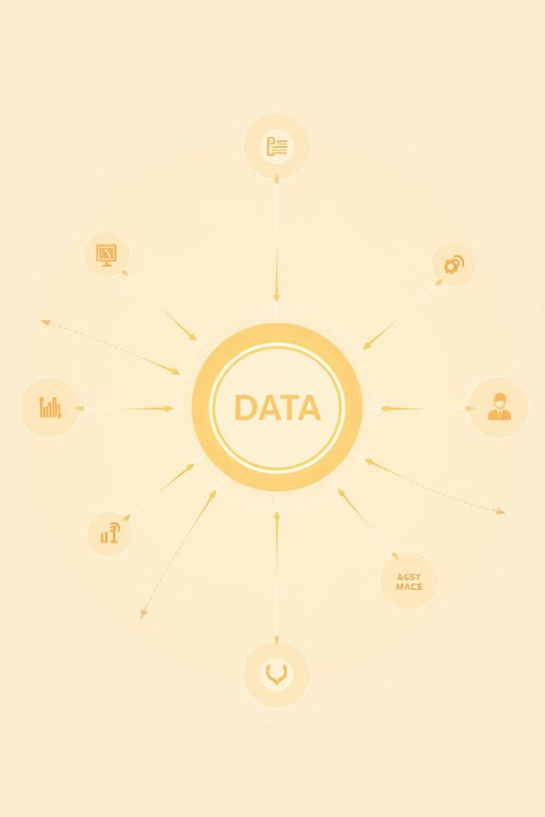
Data Sources
DBpedia
Provides static information about cities, such as name, description, geographic coordinates, and climate historical monthly data.
OpenWeatherMap
Bus API
Supplies real-time weather information, including current conditions and forecasts.
Fetches real-time bus stop information, including location, upcoming buses, and arrival times.

Slide 5
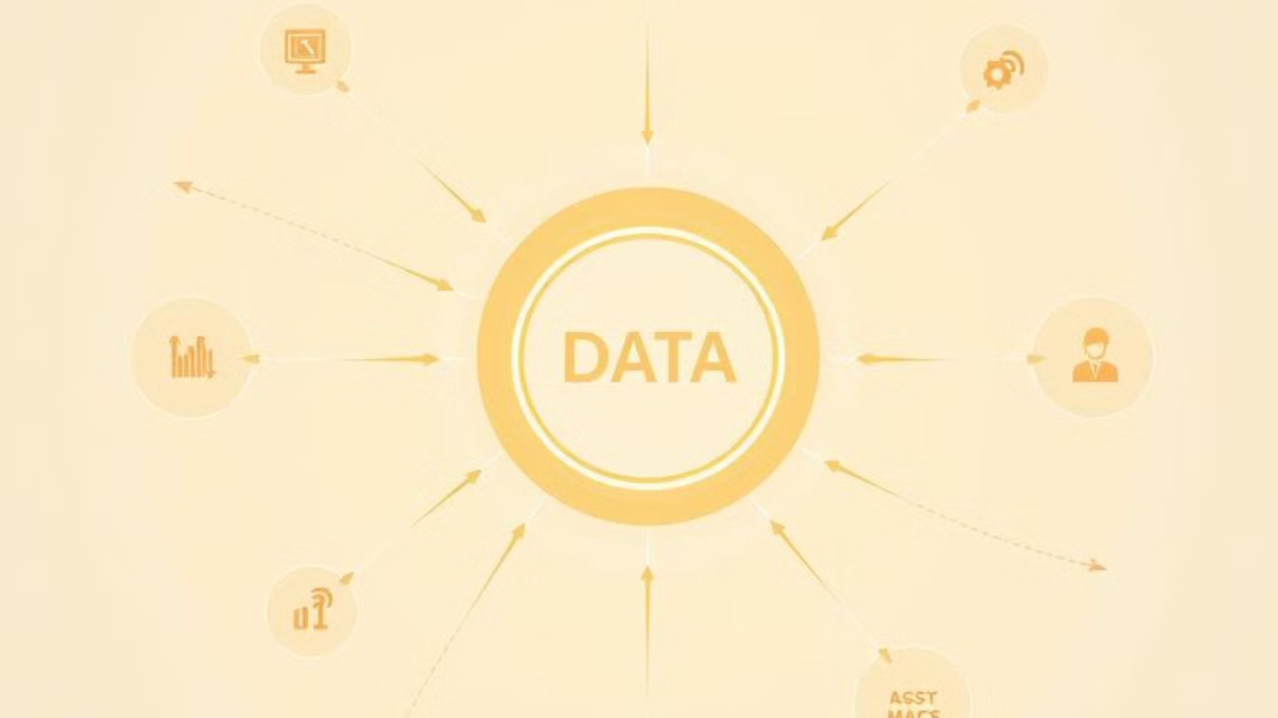
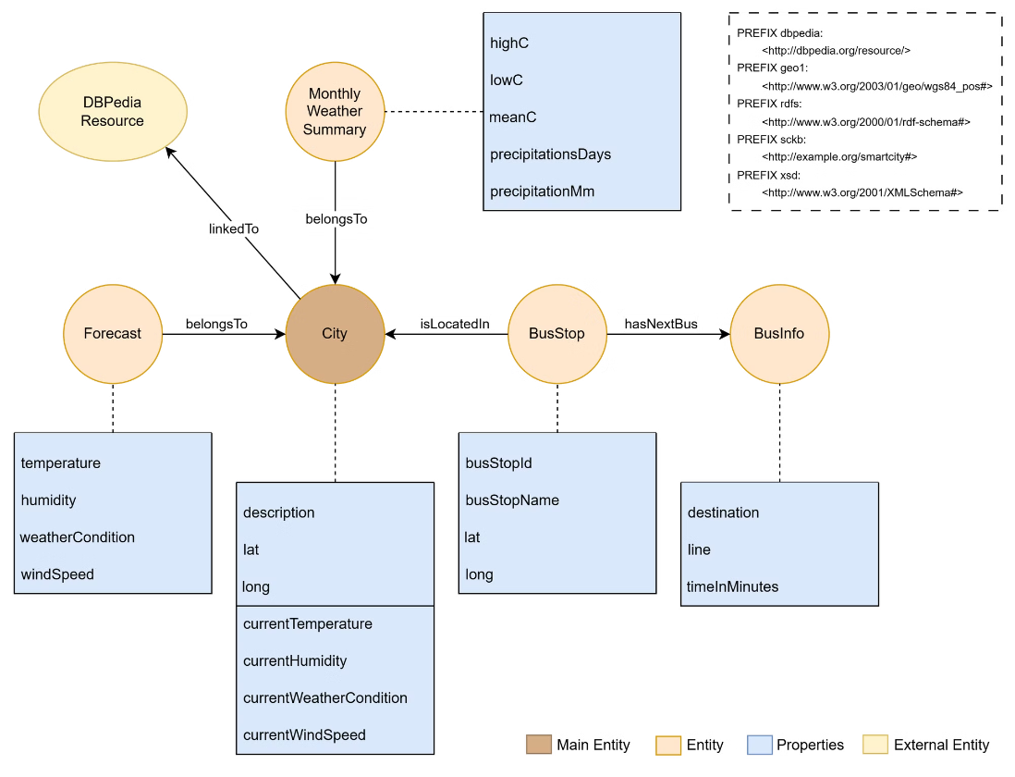
Entities and Connections

Slide 6

Linked Data Principles
1
Use URIs
2
HTTP URIs
All entities have well-defined HTTP URIs for identification.
The web application and SPARQL endpoint provide access to the resources.
3
Standard Formats
4
Link to Other URIs
RDF data is available in Turtle, JSON-LD, and XML formats.
Cities link to external DBpedia entities for seamless data integration.

Slide 7
Details on the URIs Principles
Entity
URI
HTTP URI
External URIs
City
http://example.org/smartcity#<CityName>
http://localhost:5000/<city>
http://dbpedia.org/resource/<CityName>
MonthlyWeatherSummary
http://example.org/smartcity#<CityName>/MonthlyWeatherSummary/<Month>
http://localhost:5000/<city>/monthlyweathersummary
None
Forecast
http://example.org/smartcity#CityName/Forecast/<Forecast>
http://localhost:5000/<city>/forecast
None
BusStop
http://example.org/smartcity#<CityName>/BusStop/<BusStop>
http://localhost:5000/<city>/BusStop
None
BusInfo
http://example.org/smartcity#<CityName>/BusStop/<BusStop>/<BusInfo>
http://localhost:5000/<city>/BusStop/stop_<BusStop>
None
Every triple has a label to provide readable information for users and queries.
RDF Data is available in Turtle, JSON-LD, and XML formats.

Slide 8


Data Collection and Updates
Click in the vídeo to see it

Slide 9
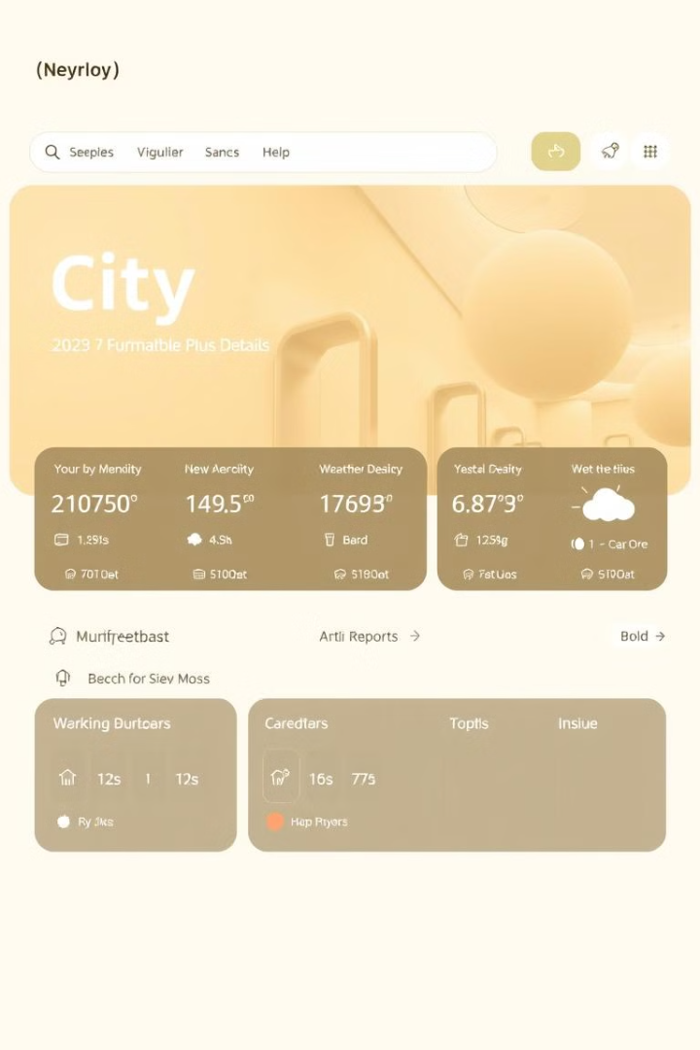





Web UI Functionalities
Search
City
Allows users to search for cities.
Displays city details and real-time current weather conditions.
Weather
Bus Stop & Info
Provide historical weather monthly data as well as forecasts for the next 5 days.
Real-time information of bus stops and next buses through a map.
Content Negotiation
The server processes requests for different data formats using the Accept headers provided by the client. Based on these headers, the server forwards the request to the Jena Fuseki server, which is capable of returning responses in multiple standard formats (e.g., JSON, XML, Turtle, CSV) as per the content negotiation mechanism.

Slide 10
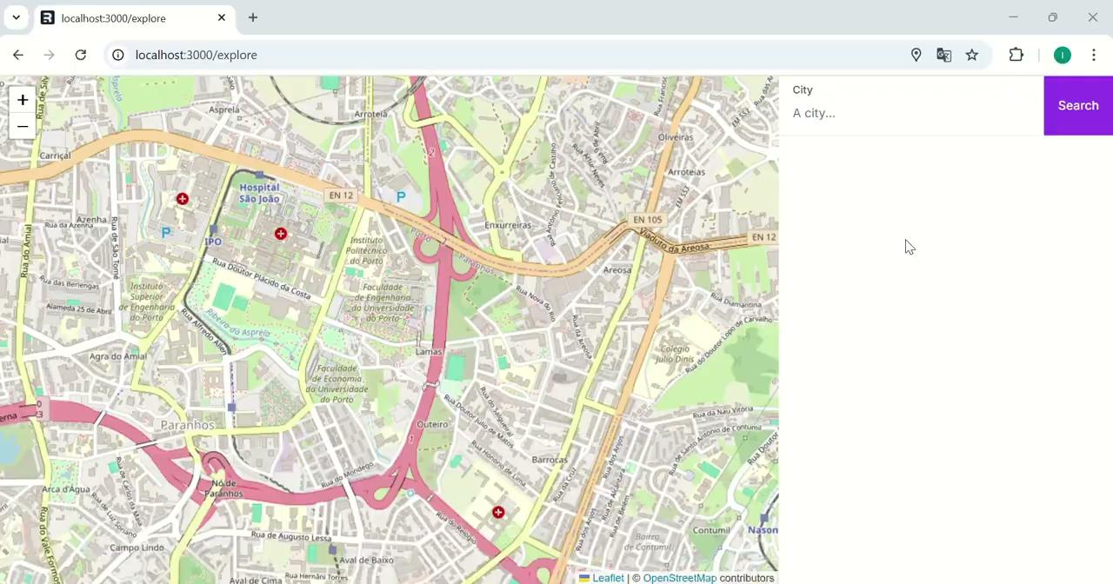
Demo
Click in the vídeo to see it

Slide 11
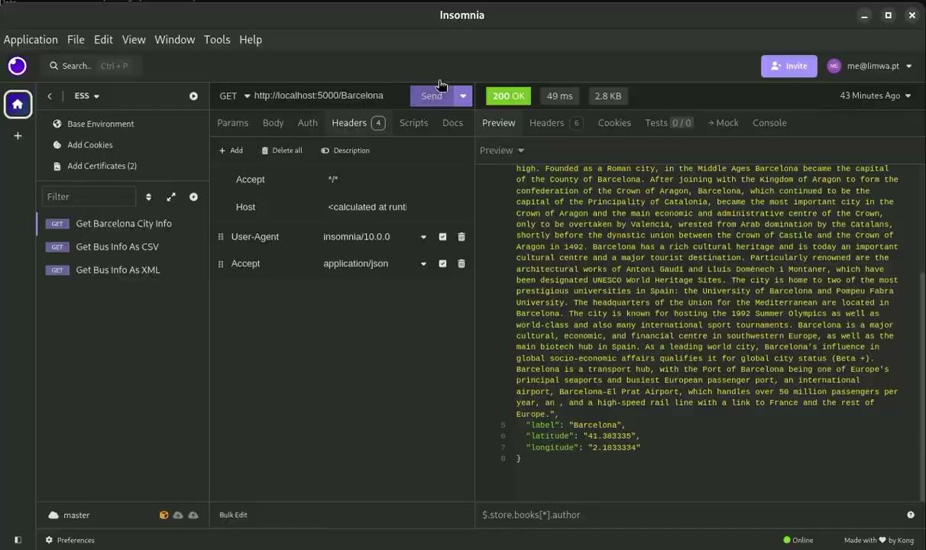
Content Negotiation Example
Click in the vídeo to see it

Slide 12
Future Sources Integration
City News
1
News related to the City, based on the themes presented.
Traffic Congestion
2
Real-time traffic data for route optimization.
Routes Under Construction
3
Alerts for closed roads and alternative routes.
Police Operations
4
Updates for public safety and prioritized traffic flow.

Slide 13


Conclusion
SmartCity-KB demonstrates the potential of integrating heterogeneous data sources into a unified RDF-based system, compliant with Linked Data principles. This project serves as Minimum Value Product for smart city applications, providing insights that can benefit citizens, planners, and smart systems alike.
Repository: https://github.com/iamaccosta/Feup-WSDL/tree/main

